Slide 1
PROJECT 1: SERVERLESS IMAGE PROCESSING
An Introduction to serverless image processing on AWS
Team members:
Uddeshya Shukla
Anushka Sahu
Manish Sinha
Shraddha Srivastava

Slide 2
AGENDA
Introduction
What is server processing?
Advantages of server processing.
Architecture of server processing.
Use Cases.
Summary
Security and privacy

Slide 3
INTRODUCTION
Efficient Image Processing with Serverless Architecture on Amazon S3 allows for scalable and cost-effective image processing. with this architecture processing times are reduced and server.

Slide 4
WHAT IS SERVERLESS PROCESSING?
Serverless computing allows you to build and
Applications and services without thinking
About servers.With Serverless computing,your
Application still runs on servers, but all the server
management done by AWS.
Serverless image processing refers to the practice of utilizing Serverless computing
Platforms to perform image processing tasks without the need to manage servers.

Slide 5
ADVANTAGES
Cost-Efficiency: serverless platforms charge you based on the actual usage of resources, which can be very cost-effective for unpredictable image processing tasks.
Scalability: Automatically scale to handle varying workloads.
No infrastructure management: Focus on code development, not server maintenance.
Flexibility: Support for multiple programming languages and frameworks.

Slide 6
ARCHITECTURE OF SERVERLESS IMAGE PROCESSING
IMAGE-PROCESSING: The original images are stored in cloud storage devices such as Amazon s3 bucket. This is where the serverless functions like lambda will retrieve the image for processing.
LOGIC: You write the logic as functions. These functions can be written in languages like python,java,node.js etc. the code receives an event trigger and stores the processed images back in storage.

Slide 7
Use cases. Face-Detection and Recognition: Utilize Amazon recognition to detect and recognize faces in images. Document-Processing: Extract text or data from images of documents ,receipts ,forms and convert them into searchable and structured formats. Image Resizing and optimizations: Automatically resize, compress and optimize images for different devices and screen sizes in real-time , enhancing user experience and website performance.

Slide 8
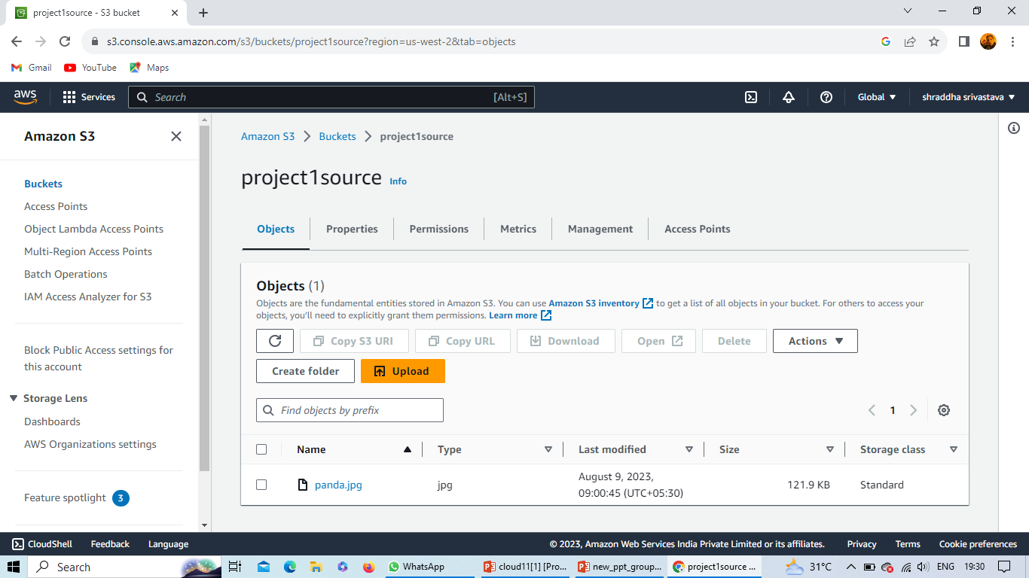
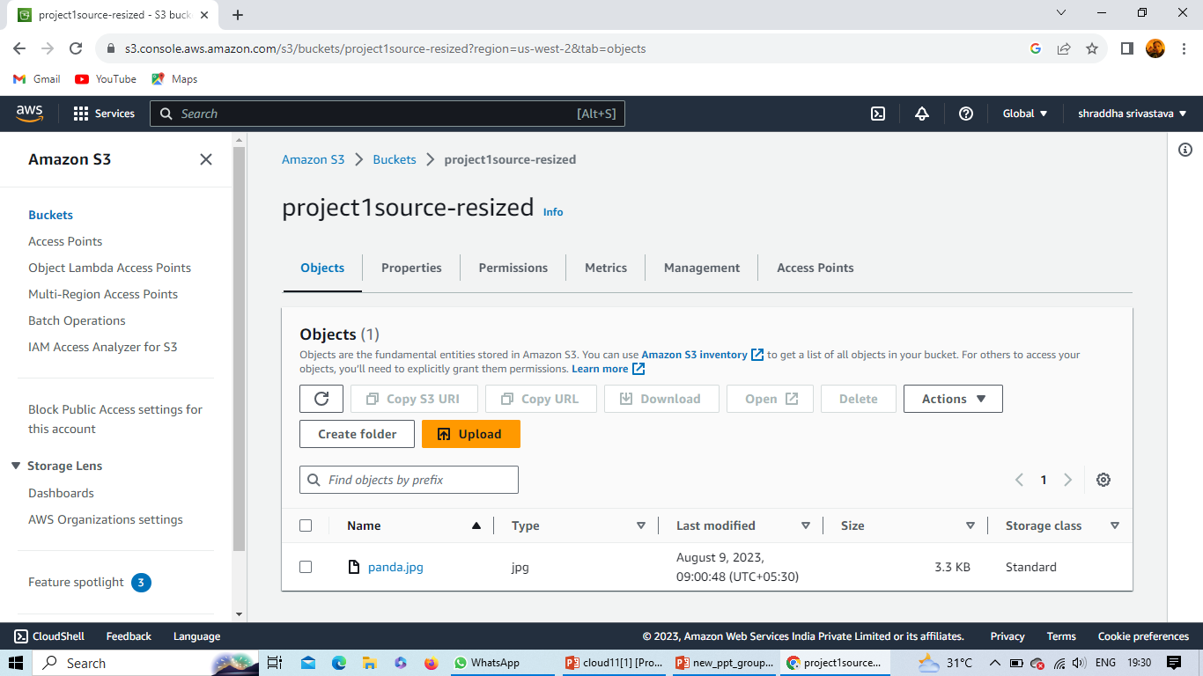
Serverless image processing
Step1- First we create two buckets where in one bucket we upload a image and second bucket is used for automatically uploading resized images.
Step2- Create a lambda function and add a trigger for s3 bucket.
Step3- Create a IAM role for making a policy to access lambda function and s3 bucket.
Step4- In lambda function, select a programming language for code then test it in run management configuration.
Step5- after executing successfully we can check resize image in s3bucket.

Slide 9
Security and Privacy
Address security concerns related to serverless image processing, such as data protection and access control.
Use AWS identity and access management to define fine-grained permissions for your serverless functions, limiting who can invoke them and access resources.
We can encrypt our data and input validation, least
Privilege principle.

Slide 10
Summary
By embracing serverless-architecture , image storage , event-driven principles and leveraging AWS services, image serverless processing in the AWS cloud become a versatile and powerful solution for various use cases while ensuring security, privacy and efficiency.

Slide 11
PROJECT 2: Static Website Hosting Using AWS
An Introduction to Hosting Static Websites on Amazon Web Services
Team members:
Uddeshya Shukla
Anushka Sahu
Manish Sinha
Shraddha Srivastava

Slide 12
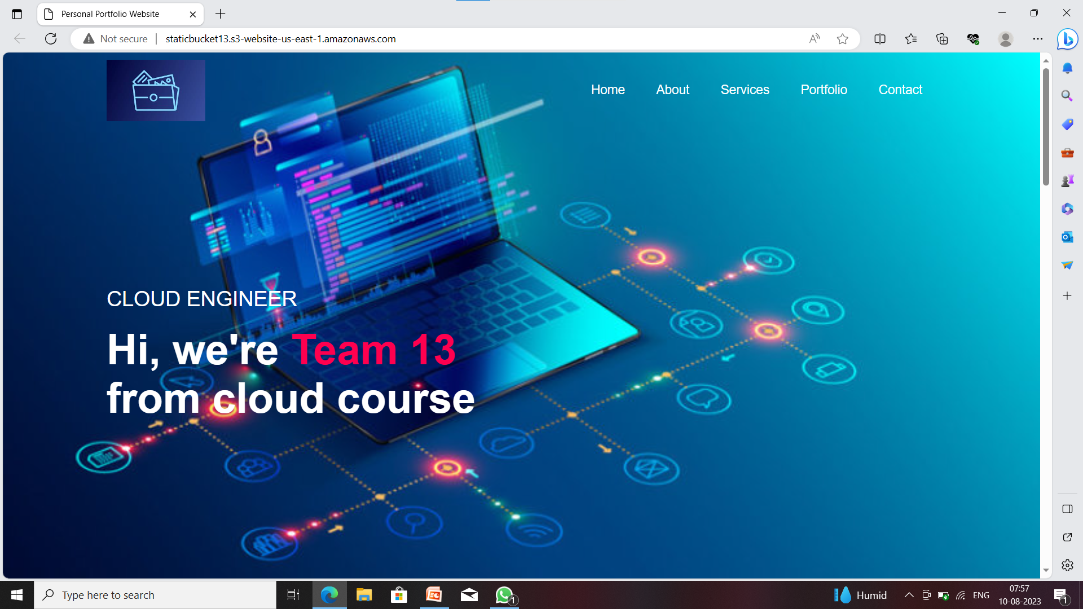
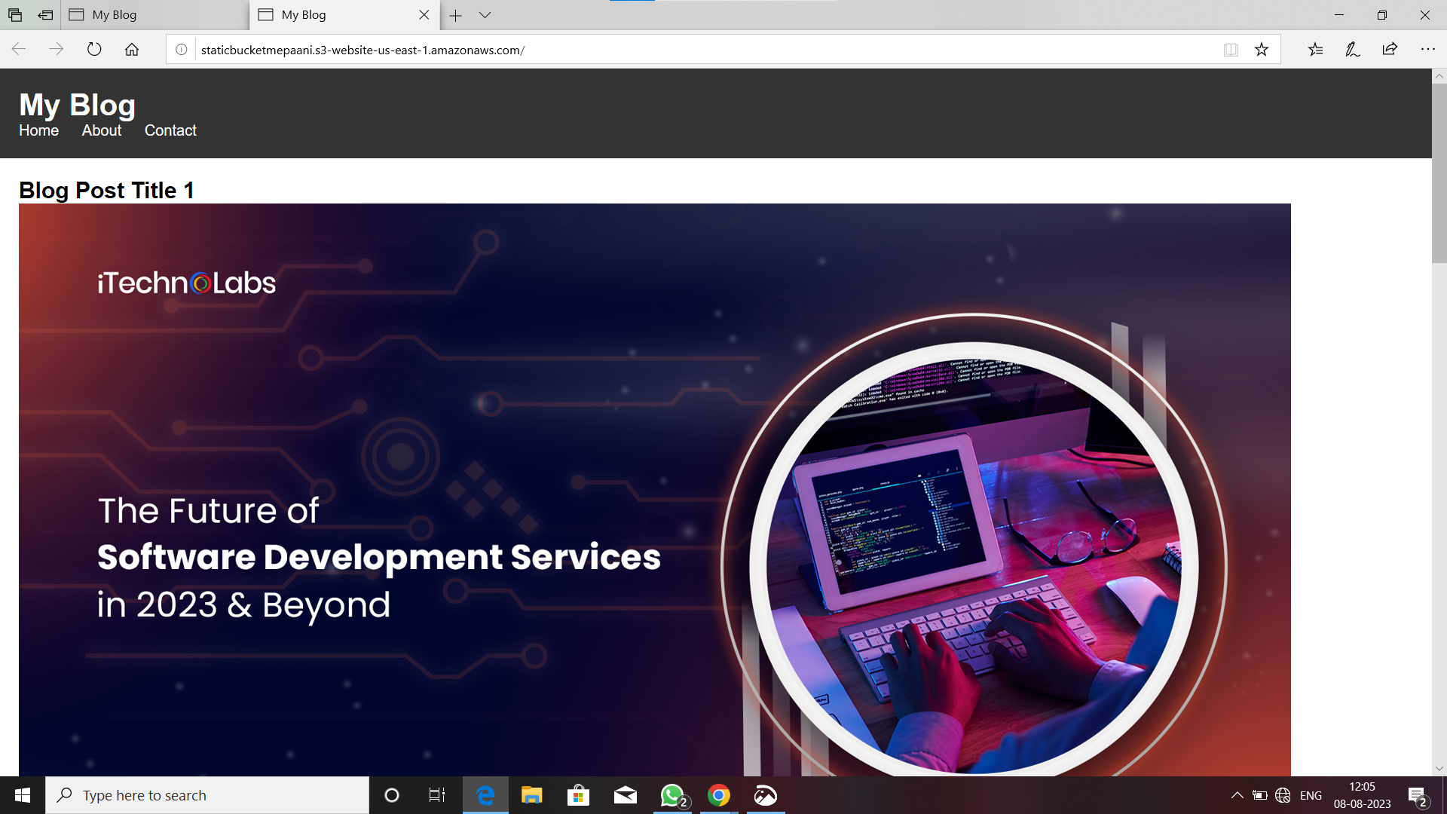

Slide 13

INTRODUCTION:
Any Static Website can be hosted quickly using Amazon Simple Storage Service(S3) ,which support static web hosting

Slide 14

AMAZON S3
Amazon S3 (Simple Storage Service) is a scalable storage solution. Create an S3 bucket, upload website assets, and enable static website hosting.

Slide 15
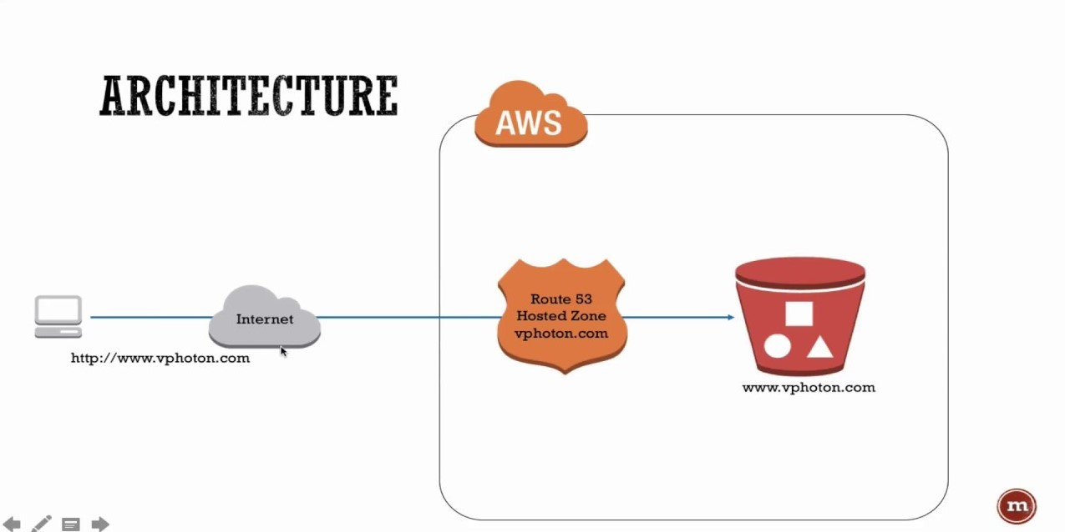
HOSTING CONFIGURATION
Configure your S3 bucket for static website hosting. Set index and error documents for your website.

Slide 16
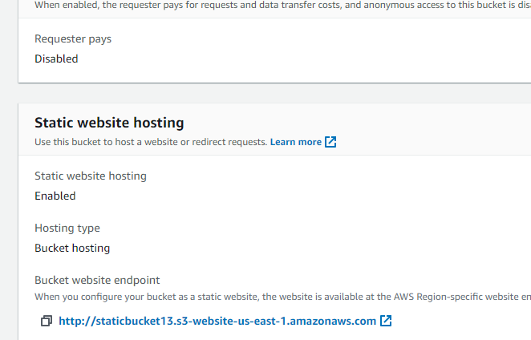
TESTING AND DEPLOYMENT
Under Buckets, choose the name of your bucket.
Choose Properties.
At the bottom of the page, under Static website hosting, choose your Bucket website endpoint.Your index document opens in a separate browser window.

Slide 17
CONCLUSION
AWS Simple Storage Service (S3) supports static web hosting. A static website has static content created in HTML, CSS, and JavaScript. S3 does not support dynamic web hosting, where the website content is generated dynamically by server-side scripts. It's important to remember that AWS S3 static webpages do not support HTTPS.

